Slide 1
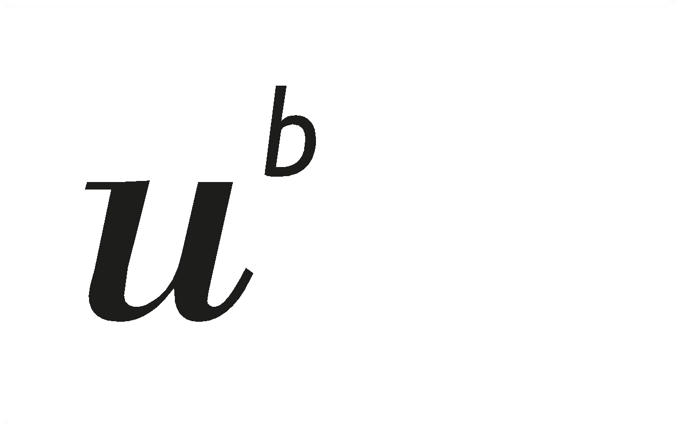
Swiss Post Sorting Centers Package Sorting Performance Analysis and Prediction

Slide 2
Objective
The goal of this project is to analyze the postal sorting center's performance by identifying the most influential factors contributing to sorting issues, including shipment attributes (e.g., dimensions, weight, coding stations, and timestamps) as well as chute congestion which we believe have a major impact on overall performance of the center and finally using a model to determine whether overburdened chutes or certain features create bottlenecks that reduce overall system efficiency.
Determine Feature Importance: Rank the shipment features by their importance and identify which shipment attributes (e.g., dimensions, weight, coding station) are most influential in causing sorting issues at postal centers. As well Correlation between the features and the impact on performance
Determine chute congestion impact: Determine whether chutes are handling disproportionately large volumes of packages can create bottlenecks that reduce overall system efficiency
Predict Sorting Performance and Issues: Develop a predictive model capable of forecasting sorting issues based on historical shipment data.
Generate Actionable Insights: Provide data-driven recommendations for improving chute utilization and enhance overall performance

Slide 3
Sorting Process
A: Shipments arrive and are delivered to the sorting center, using designated units
B: Shipments are scanned and transferred to the conveyor belts, where automatic and manual sorting machines determine their route and send them to the appropriate chute based on the destination.
C: The chute serves as the output of the sorting machine, directing the parcels to different destinations depending on the ZIP code., one chute can serve several ZIP codes
The center's performance is measured by the number of parcels processed per time frame. Some centers have shown up to a 15% increase in processing efficiency compared to others with similar setups. Further investigation revealed that traffic bottlenecks at certain chutes, which handle significantly higher package volumes, cause an imbalance. This results in a non-normal distribution of packages across the chutes, leading to a noticeable reduction in overall performance.
Our goal is to achieve a balanced, normally distributed flow of packages across all available chutes, which would enhance the sorting rate and improve overall center performance.

Slide 4
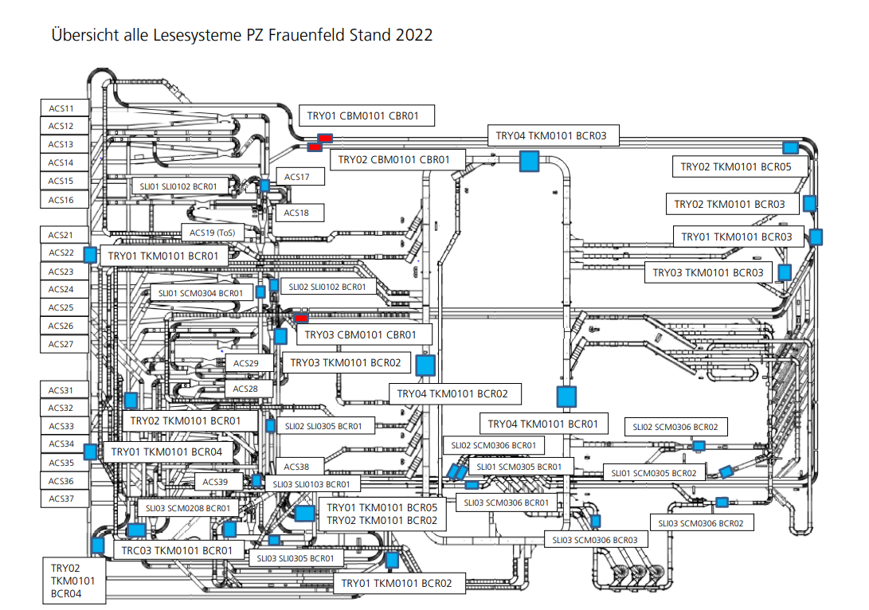
Sorting Process

Slide 5
Overview of provided Data
The data for this project comes from Swiss Post's shipment sorting system and includes:
Shipment number (anonymized) SND_IDENTCODE
Shipment dimensions: Length, width, and height (in millimeters) SND_CODS_DIM1, SND_CODS_DIM2, SND_CODS_DIM3
Shipment weight: (n grams) SND_GEW
Scanning timestamps when the item first scanned in the sorting center CODS_COD_DAT
Scanner station: Sorting station identifier CODS_CO_STATION
Sorting center Number CODS_ZENT_NR_x
leaving timestamps when the item left the sorting center chute CODS_LERE_DAT
chute station where the item is sent CODS_SD_RUTSCHE
The Engineered Features
Shipment dimensions SUM: Length+width+height CODS_DIM_SUM as they always corelate together
Processing Time : the processing time processing_time_minutes = entry time – leaving time
Sorting Performance : the processing time if longer than 10 min its performance issue 1 else 0
Minute counter : the time package leaving Center as counter from 01.01.2024

Slide 6
Overview of provided Data
Field Name | Description | Data Type | Example
SND_IDENTCODE | Unique identifier for each shipment (anonymized for privacy) | String | A12345
SND_CODS_DIM1 | Length of the shipment in millimeters | Integer | 300
SND_CODS_DIM2 | Width of the shipment in millimeters | Integer | 150
SND_CODS_DIM3 | Height of the shipment in millimeters | Integer | 50
SND_GEW | Weight of the shipment in grams | Integer | 1000
CODS_COD_DAT | Timestamp indicating when the shipment was scanned into the sorting center | Datetime | 15.01.2023 08:32
CODS_LERE_DAT | Timestamp indicating when the shipment left the sorting center | Datetime | 15.01.2023 09:45
CODS_CO_STATION | Station or scanner ID at which the shipment was processed | String | STATION01
CODS_SD_RUTSCHE | Chute identifier where the package was routed for further processing | String | CHUTE10
processing_time_minutes | Calculated field representing the time taken to process a shipment in minutes | Float | 73.5

Slide 7
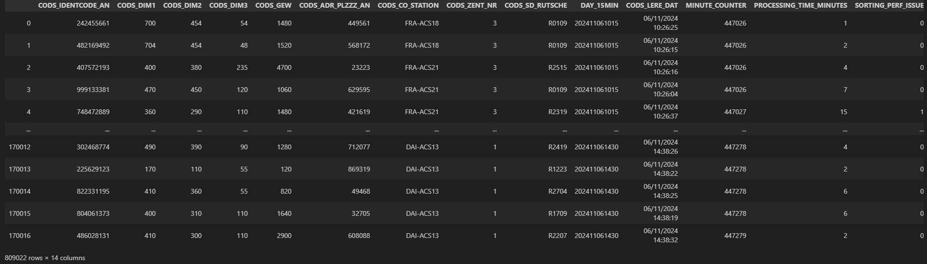
Overview of provided Data

Slide 8
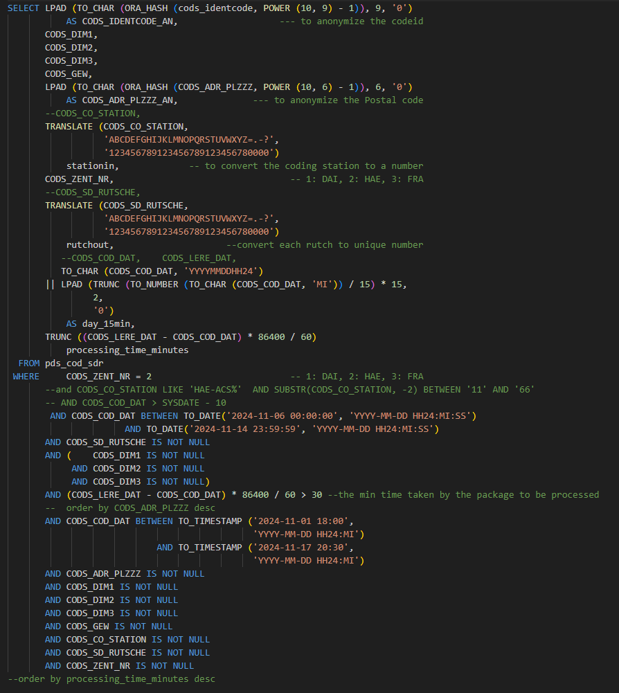
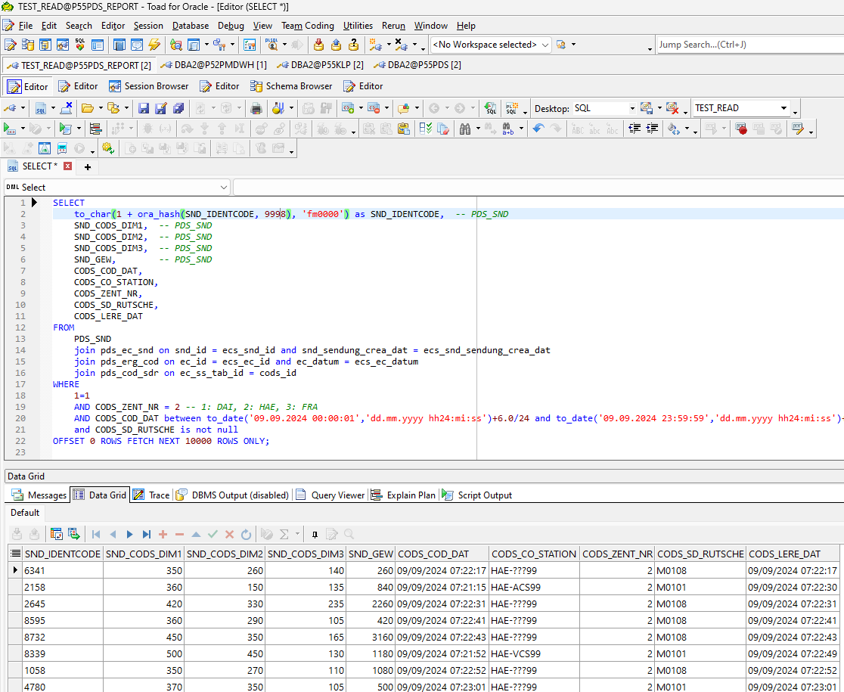
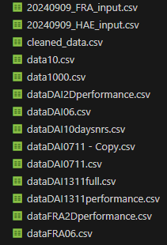
Overview of provided Data

Slide 9
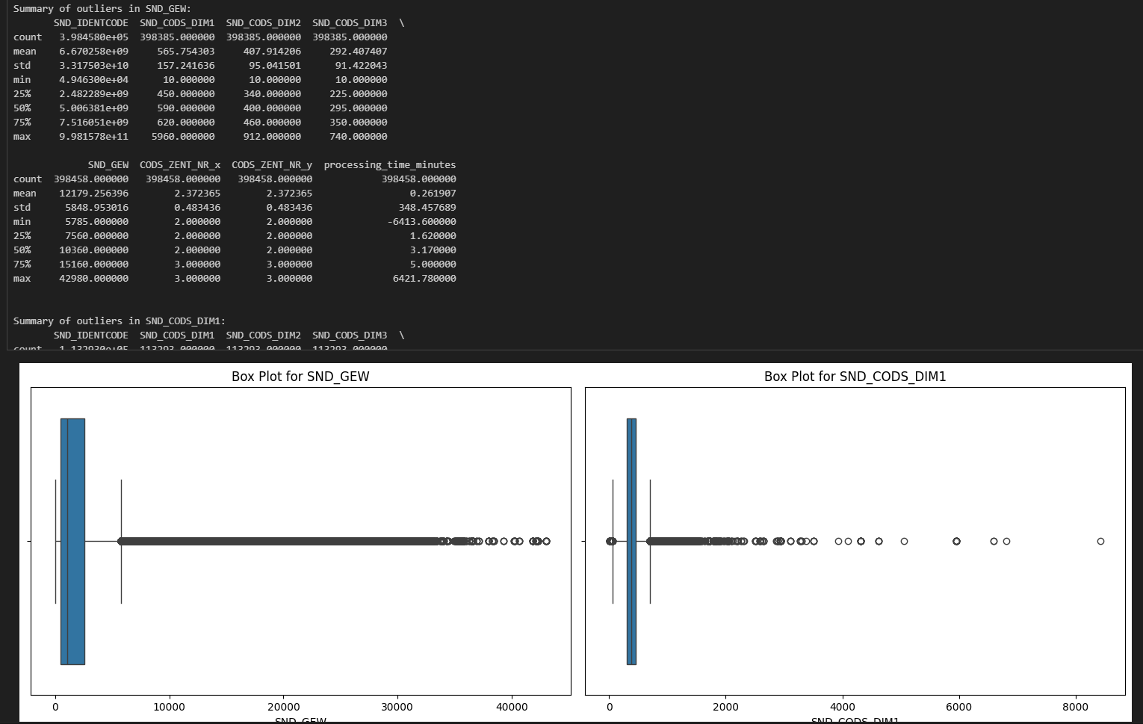
Descriptive Statistics

Slide 10
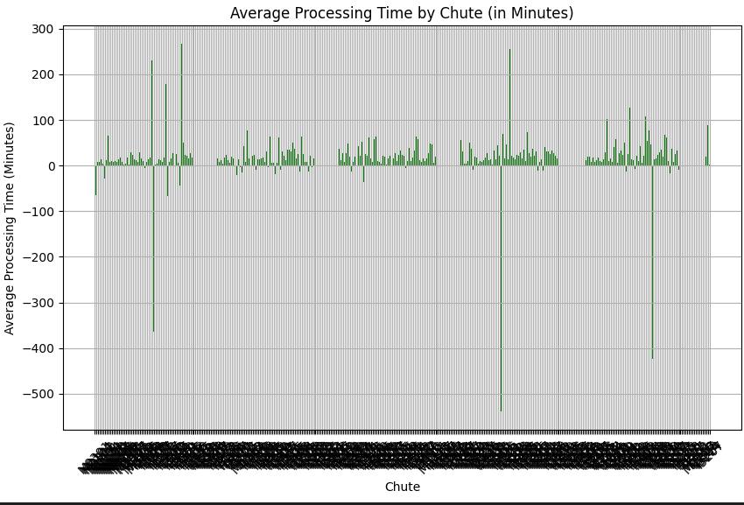
Descriptive Statistics

Slide 11
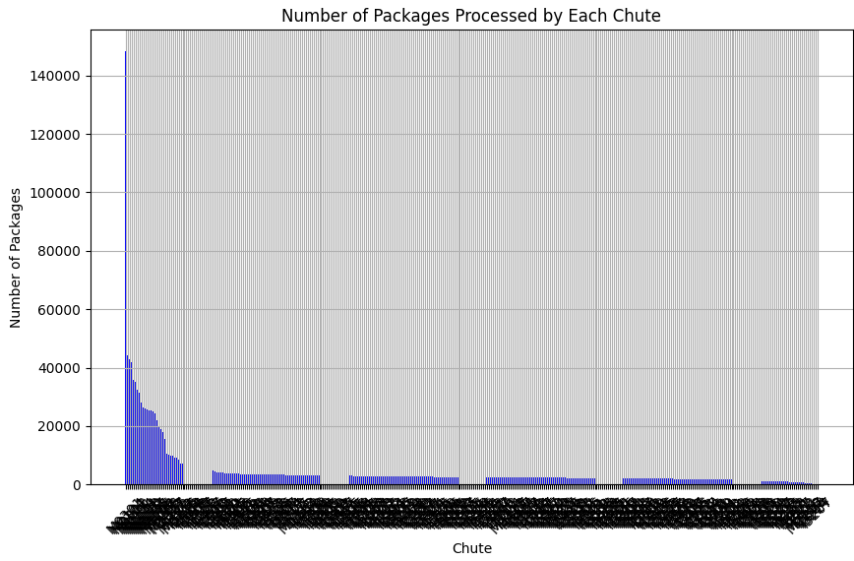
Descriptive Statistics

Slide 12
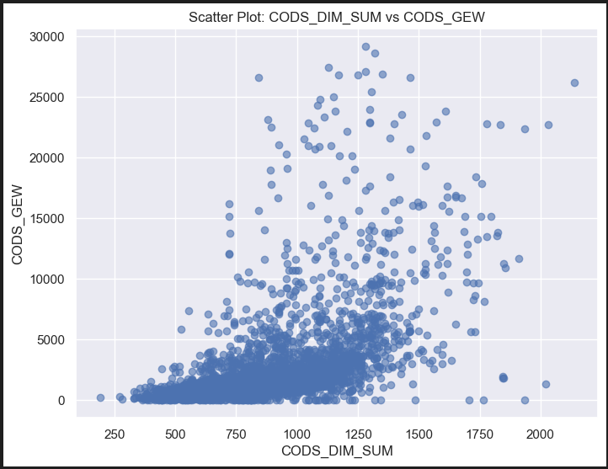
Descriptive Statistics

Slide 13
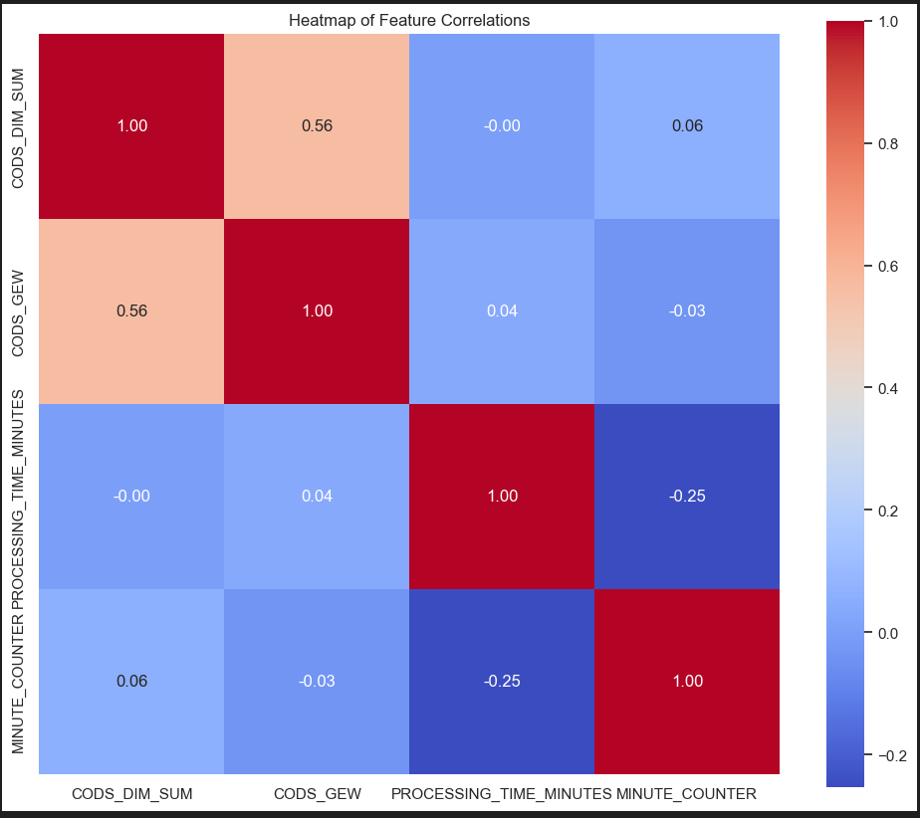
Heat Map

Slide 14
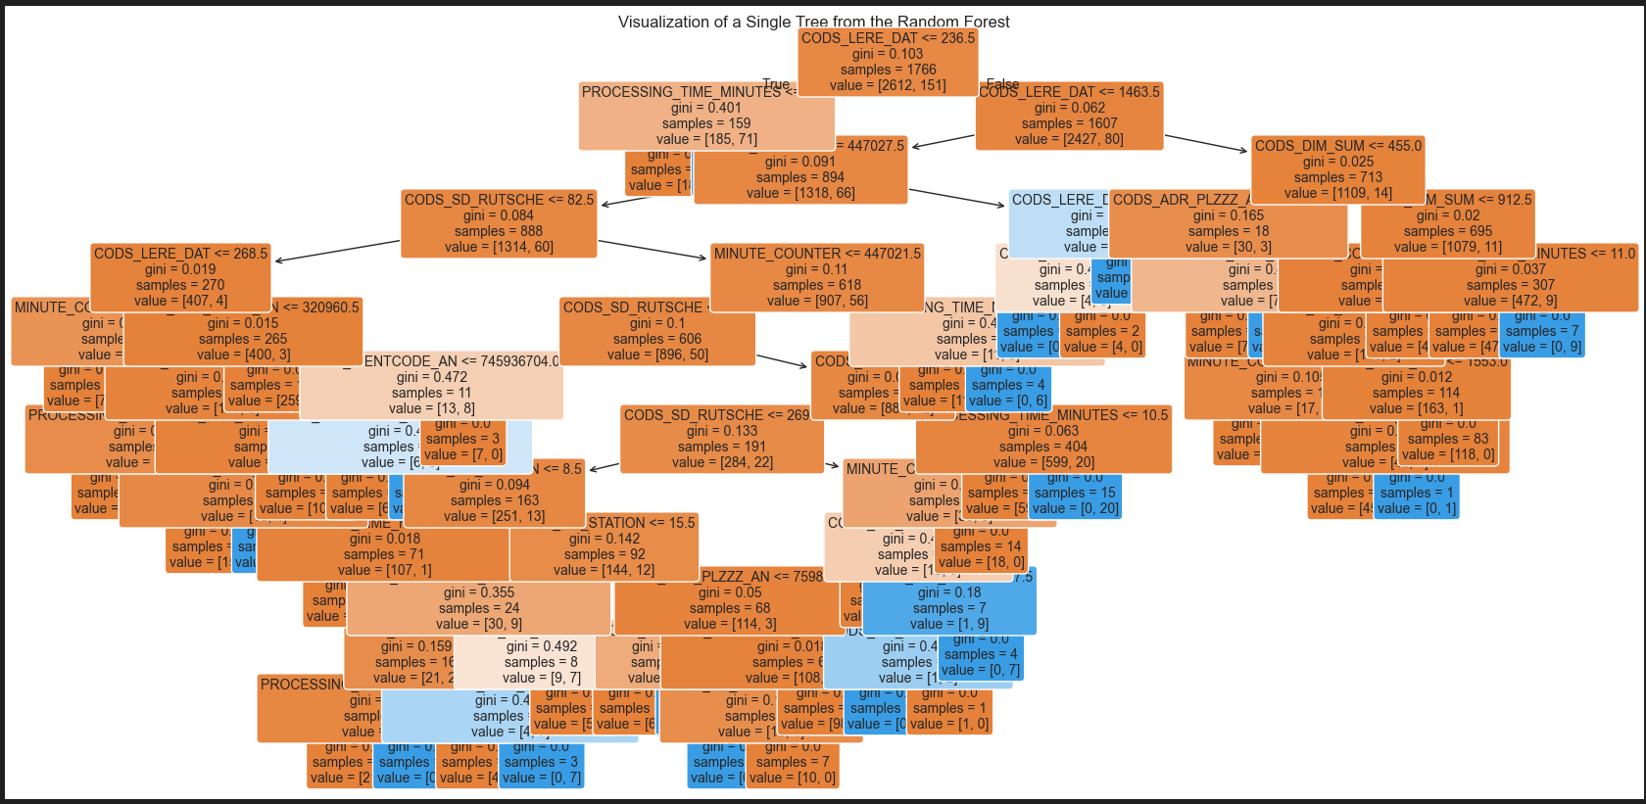
Random Forest

Slide 15
Result of Statistical Tests
Understanding which features most affect sorting issues provides insights that can be used to improve sorting operations at Swiss Post. Focusing on key factors like shipment size, weight, and station performance will help optimize sorting machine performance and reduce errors.
Key Findings
Chute Congestion: Certain chutes were identified as potential bottlenecks, handling significantly more packages than others and showing longer processing times. Managing chute congestion is critical to improving overall efficiency.
Processing Time Variability: There was substantial variability in processing times across shipments. Factors such as shipment dimensions, weight, and chute assignment contributed to this variability.
Data Quality Issues: Several data quality issues, such as missing or inconsistent timestamps, were identified. These issues were addressed to ensure accurate analysis, but continued data quality monitoring is recommended.
Model Insights
The Random Forest model provided insights into the factors most influencing sorting performance, with shipment weight and chute utilization being significant contributors. However, additional factors not captured in the dataset may also play a role in performance variations.

Slide 16
Result of Statistical Tests
Recommendations
Chute Balancing: Implement dynamic chute load balancing to distribute shipments more evenly across available chutes. This would reduce bottlenecks and improve throughput.
Real-Time Monitoring: Introduce real-time monitoring to detect and address chute congestion before it affects overall performance.
Further Data Collection: Collect additional data on shipment characteristics and operational factors to refine the performance models and improve accuracy.
Next Steps
Continue refining the performance models with updated data and explore additional machine learning techniques to predict sorting center performance under different conditions.
Implement operational changes based on the findings and monitor their impact on sorting efficiency.

Slide 17
Transitioning from Dimensions to ZIP and Chute-Based Modeling
Rationale for Transitioning from Package Dimensions to ZIP Code and Chute-Based Modeling
Package volume had minimal impact on operational performance — the primary driver of chute congestion was the number of packages, not their size.
ZIP code is the decisive factor in routing, directly determining chute assignment and downstream load.
Tracking package dimensions introduced unnecessary complexity with no measurable gain in predictive accuracy.
By focusing on ZIP and chute-level volume, we improved model efficiency, reliability, and interpretability.
The new approach aligns better with operational levers — it's feasible to reallocate ZIP codes across chutes, but not to adjust package size.
Result: a leaner, faster, and more actionable model that directly supports real-time decision-making.

Slide 18
LSTM
Why We Chose LSTM for This Project
1. Nature of the Problem: Sequential and Time-Dependent
Our data reflects time-series behavior — package volumes fluctuate over time, influenced by hour-of-day, ZIP routing patterns, and operational cycles.
Chute congestion is not static; it depends on past trends, like package surges building up over time.
We needed a model that could learn from historical patterns to predict upcoming performance issues.
2. LSTM (Long Short-Term Memory) Is Built for Time-Series
LSTM is a specialized form of Recurrent Neural Network (RNN) designed to retain memory over time.
Unlike standard models, LSTM can capture long-term dependencies, such as consistent overloads during specific hours or recurring ZIP surges.
It excels at detecting trends and seasonality — perfect for forecasting operational bottlenecks.
3. Handles Non-Linear and Complex Patterns
Chute performance is impacted by non-linear combinations of ZIP code volume, station load, and time.
LSTM handles these complex interactions far better than traditional regression or rule-based models.

Slide 19
LSTM Model Performance Comparison: All Chutes vs Top 20 Chutes
Original Model (All Chutes, Hourly Aggregation): Input Data: Included all chutes over 30 days, grouped by hour.
Problem: The vast majority of records had no performance issues (avg_processing_time_minutes < 10).
Consequence:
The model learned to predict near-zero processing time.
Overfitting to "normal" behavior → Poor at detecting or predicting real problems.
Forecasts were always flat and missed performance spikes.
Refined Model (Top 20 Chutes with Known Issues, 10-Minute Aggregation):
Input Data: Limited to top 20 chutes that had documented performance issues in the past 10 days.
Granularity: Switched to 10-minute intervals to better capture short-term load patterns.
Model now trains on meaningful variation and real issue patterns.
Reduced noise and class imbalance.
Much better fit for both historical prediction and 6-hour forecasting.
Early results show the model tracks spikes and processing slowdowns more accurately.
Model Version Data Scope Granularity Issue Presence Prediction Quality
Original (Baseline) All chutes Hourly Mostly 0s Poor (overfitting)
Refined (Top 20) Problematic only 10-minutes Real issues Improved accuracy

Slide 20
What are we Predicting
Primary Predictions
Average Processing Time per Chute per Hour (Regression Task)
Helps us understand whether a chute is operating normally or slowing down due to volume buildup.
Used to detect early signs of potential performance degradation.
Performance Degradation Risk (Classification Task)
Binary output: Will there be a performance issue in the next time window?
Enables real-time alerts and preventive actions before delays occur.
Current Prediction Scope
Predictions are made at the level of ZIP code + chute + hour + station.
Inputs include:
Historical package counts per ZIP/chute/hour.
Time-based features (hour of day, day of week).
Scanning station (to capture local load patterns).
Output is both continuous (processing time) and binary (issue/no issue).
Business Value
Enables proactive load balancing by flagging upcoming pressure points.
Supports ZIP re-routing strategies to reduce overload risk.
Enhances operational visibility, helping floor managers prioritize interventions.

